Slide 1
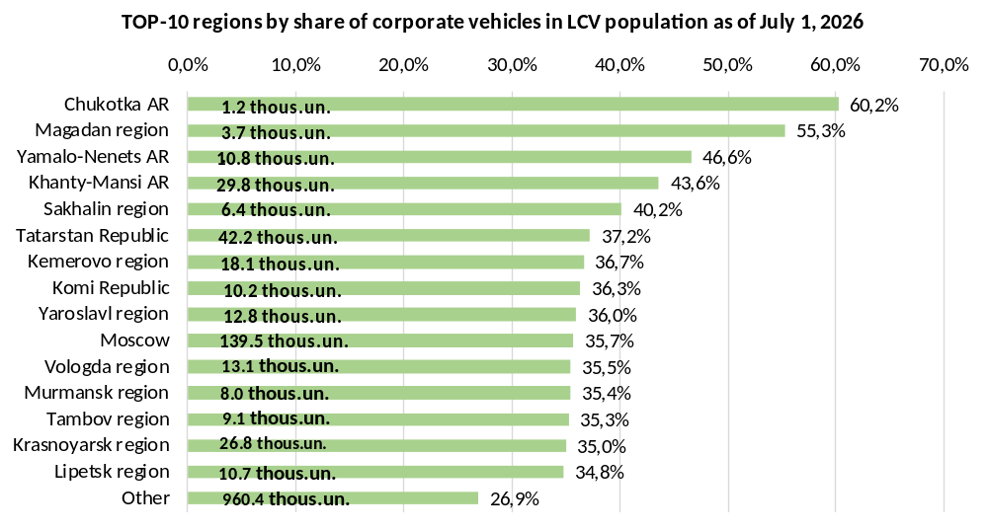
Regions with predominant number of LCV owned by corporate clients
According to the marketing agency NAPI, as of July 1, 2026, the LCV* population numbered 4.5 million vehicles. Of them 1.3 million LCV belong to corporate clients.
Vehicles owned by corporate clients account for 29.0% of the population. This share is higher in 48 Russian regions.
More than half of LCV belong to corporate clients in the Chukotka AR and the Magadan region, more than 40% - in the Yamalo-Nents AR, Khanty-Mansi AR and the Sakhalin region.
*vehicles with GVW under 6 tons, including pickups
Source: NAPI / National Industrial Information Agency

Slide 2
Regions with predominant number of LCV owned by corporate clients
According to the marketing agency NAPI, as of July 1, 2026, the LCV* population numbered 4.5 million vehicles. Of them 1.3 million LCV belong to corporate clients.
Vehicles owned by corporate clients account for 29.0% of the population. This share is higher in 48 Russian regions.
More than half of LCV belong to corporate clients in the Chukotka AR and the Magadan region, more than 40% - in the Yamalo-Nents AR, Khanty-Mansi AR and the Sakhalin region.
#НАПИ_LCV
#НАПИ_парк_техники
1.2 thous.un.
TOP-10 regions by share of corporate vehicles in LCV population as of July 1, 2026
3.7 thous.un.
.
10.8 thous.un.
29.8 thous.un.
6.4 thous.un.
42.2 thous.un.
18.1 thous.un.
10.2 thous.un.
12.8 thous.un.
139.5 thous.un.
13.1 thous.un.
8.0 thous.un.
9.1 thous.un.
26.8 thous.un.
10.7 thous.un.
960.4 thous.un.
*vehicles with GVW under 6 tons, including pickups
Source: NAPI / National Industrial Information Agency

