Slide 1

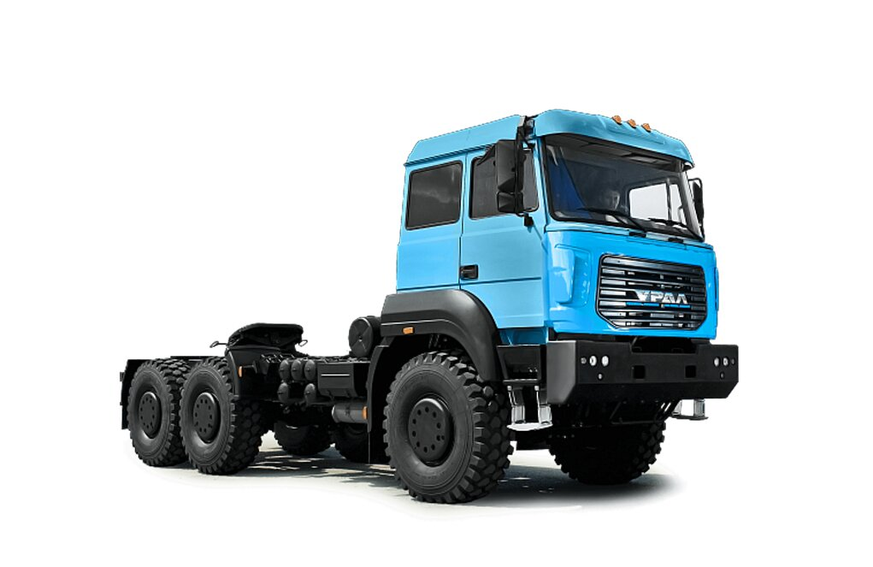

Total cost of ownership of URAL 63704K 3951 tractor unit
1
The marketing agency NAPI analyzed the total cost of ownership of URAL 63704K 3951 tractor unit equipped with CNG engine in various regions of Russia using the DV – TCO online total cost of ownership calculator.
Region | Moscow
Ownership term, months | 60
Average annual mileage, km | 100 000
Total mileage, km | 500 000
TCO, Rub | March 2024 | March 2025
Vehicle cost | 11 000 000.00 | 13 500 000.00
TCO per km | 28.12 | 31.61
TCO per month | 398 349.37 | 447 811.68
TCO per year | 4 780 192.40 | 5 373 740.21
TCO for 5 years | 23 900 961.99 | 26 868 701.06
Major costs, Rub
Transport tax | 101 750.00 | 101 750.00
State duty | 2 850.00 | 2 850.00
Maintenance cost | 2 874 977.00 | 3 389 876.00
Total fuel cost | 11 305 578.00 | 12 277 655.00
Tires and tire service | 1 642 000.00 | 1 764 000.00
MTPL for 5 years | 265 169.90 | 265 169.90
Hull insurance for 5 years | 1 130 066.63 | 1 639 799.91
Depreciation | 3 514 920.46 | 4 644 050.25
Residual value | 7 485 079.54 | 8 855 949.75
GVW, kg | 34 000 kg
Engine capacity, HP | 407 HP
Fuel type | CNG
Wheel arrangement | 6x6
Body type | Tractor unit
Engine model | YC6K1342N-50
Carrying capacity, kg | 13 700
Number of axles | 3
Transmission | MT
Tire size | 425/95 R20
Maintenance rate | 26
Service interval | 20 000
Repair rate | 12
TCO, March 2025, Rub | Moscow | Krasnodar region | Nizhny Novgorod region | Khabarovsk region | Irkutsk region | Stavropol region | Saint Petersburg | Chelyabinsk region
TCO per km | 31.61 | 31.74 | 32.55 | 33.48 | 32.37 | 32.17 | 32.08 | 31.38
TCO per month | 447 811.68 | 449 598.99 | 461 137.38 | 474 324.86 | 458 575.63 | 455 742.35 | 454 469.84 | 444 509.13
TCO per year | 5 373 740.21 | 5 395 187.90 | 5 533 648.60 | 5 691 898.33 | 5 502 907.59 | 5 468 908.15 | 5 453 638.06 | 5 334 109.57
TCO for 5 years | 26 868 701.06 | 26 975 939.49 | 27 668 242.99 | 28 459 491.66 | 27 514 537.94 | 27 344 540.76 | 27 268 190.32 | 26 670 547.85
www.napinfo.ru
NAPI / National Industrial Information Agency

