Slide 1

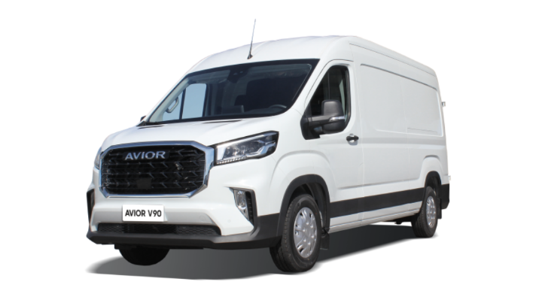

Total cost of ownership of AVIOR V90 N1 L3 H2 all-metal van leased
1
The marketing agency NAPI has developed a new tool for calculating the total cost of ownership: a detailed calculation of vehicle acquisition on lease.
As an example, NAPI calculated the total cost of ownership of AVIOR V90N1L3H2 all-metal van, acquired on lease, in the Moscow fleet using the DV – TCO online total cost of ownership calculator.
www.napinfo.ru
Source: NAPI / National Industrial Information Agency

