Slide 1
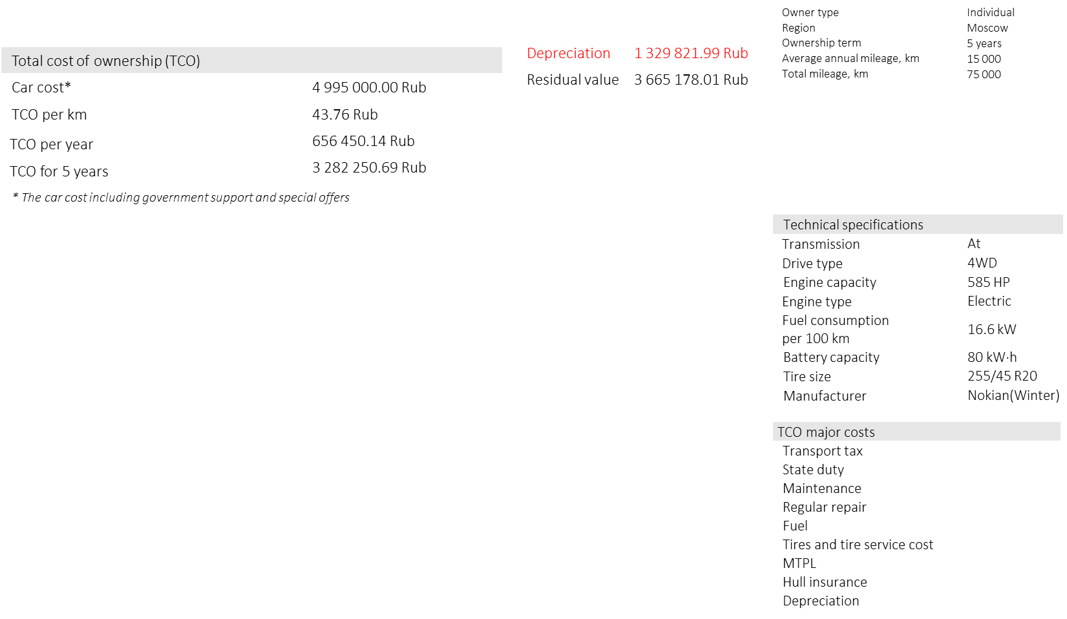
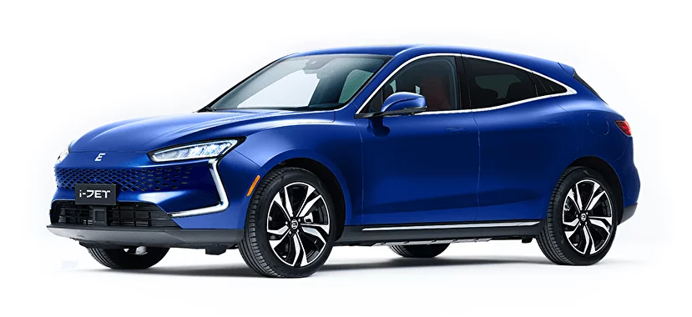
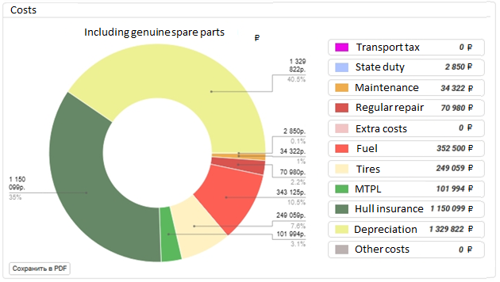
DV-TCO ONLINE CALCULATOR
1
CALCULATION OF TOTAL COST OF OWNERSHIP OF EVOLUT JET
www.napinfo.ru
Source: NAPI / National Industrial Information Agency

Slide 2
DV-TCO ONLINE CALCULATOR
2
CALCULATION OF TOTAL COST OF OWNERSHIP OF EVOLUT JET
Owner type | Individual
Region | Moscow
Ownership term | 5 years
Average annual mileage, km | 15 000
Total mileage, km | 75 000
Total cost of ownership (TCO)
Car cost* | 4 995 000.00 Rub
TCO per km | 43.76 Rub
TCO per year | 656 450.14 Rub
TCO for 5 years | 3 282 250.69 Rub
Depreciation | 1 329 821.99 Rub
Residual value | 3 665 178.01 Rub
* The car cost including government support and special offers
Technical specifications
Transmission | At
Drive type | 4WD
Engine capacity | 585 HP
Engine type | Electric
Fuel consumption per 100 km | 16.6 kW
Battery capacity | 80 kW·h
Tire size | 255/45 R20
Manufacturer | Nokian(Winter)
TCO major costs
Transport tax
State duty
Maintenance
Regular repair
Fuel
Tires and tire service cost
MTPL
Hull insurance
Depreciation
www.napinfo.ru
Source: NAPI / National Industrial Information Agency

