Slide 1

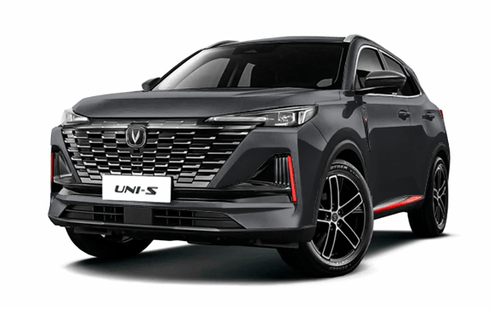

Comparison of total cost of ownership of CHANGAN UNI-S Comfort for 3 and 5 years
1
The marketing agency NAPI analyzed the total cost of ownership of CHANGAN UNI-S Comfort for 3 years and 5 years for an individual in the city of Moscow using the online DV – TCO total cost of ownership calculator.
Changan Uni-S is a front-wheel drive crossover. In January-June 2025, 19 models of Changan cars were introduced to the market. In the first half of the current year, Uni-S occupied a leading position among all Changan models, with sales volume amounting to 12.8 thousand cars.
DV-TCO online calculator calculates the total cost of ownership of trucks, light commercial vehicles, and cars
www.napinfo.ru
Source: NAPI / National Industrial Information Agency

Slide 2
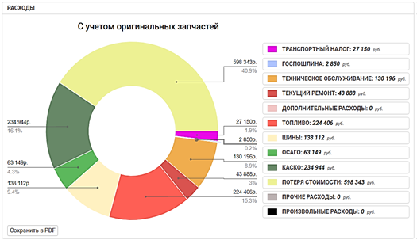
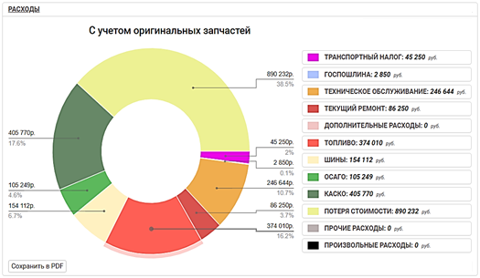
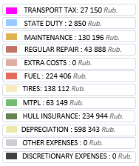
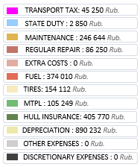
Comparison of total cost of ownership of CHANGAN UNI-S Comfort for 3 and 5 years
Total cost of ownership of CHANGAN UNI-S Comfort for 3 years
Total cost of ownership of CHANGAN UNI-S Comfort for 5 years

